Slide 1
Pokedex – Pokemon Encyclopedia
Semester – Third
Python and FSD - 1 Combined project
Batch – B9
Members:
Parth Nayan Kshatri – 25002171220012
Akshat Tapan Chauhan = 25002171220003

Slide 2
Project Description
The main goal of this project was to implement the subjects and content we have learned so far in this semester by creating a component of a really popular TV show called Pokemon
This project contains the following function:
Text based search system
Image recognizing search system
Database using SQLite handling different users by storing their teams and storage
Bootstrap and FastAPI implemention
Hashing algorithms using SHA-256 and uuid-18 for token generation

Slide 3
Used file with description
Project_minization.py – Main python file with all the functionality and FastAPI linking
Web1/index.html – Main html file with all the frontend logic
Static – contains all the images and css file
Static/web.css – css file used for the formatting and visuals of html
Database.py – Main file that contains the description and key allocations for the database

Slide 4
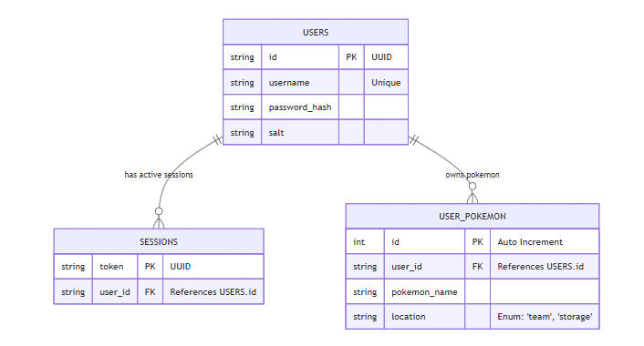
ER Diagram
Entities Description:
USERS: Stores user credentials and identification.
SESSIONS: Manages active user login sessions using tokens.
USER_POKEMON: Tracks pokemon caught by users, indicating whether they are in the active 'team' or generally in 'storage'.

Slide 5
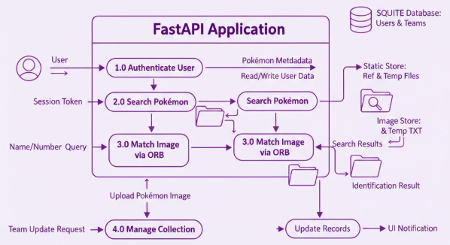
Data Flow Diagram

